Slide 1
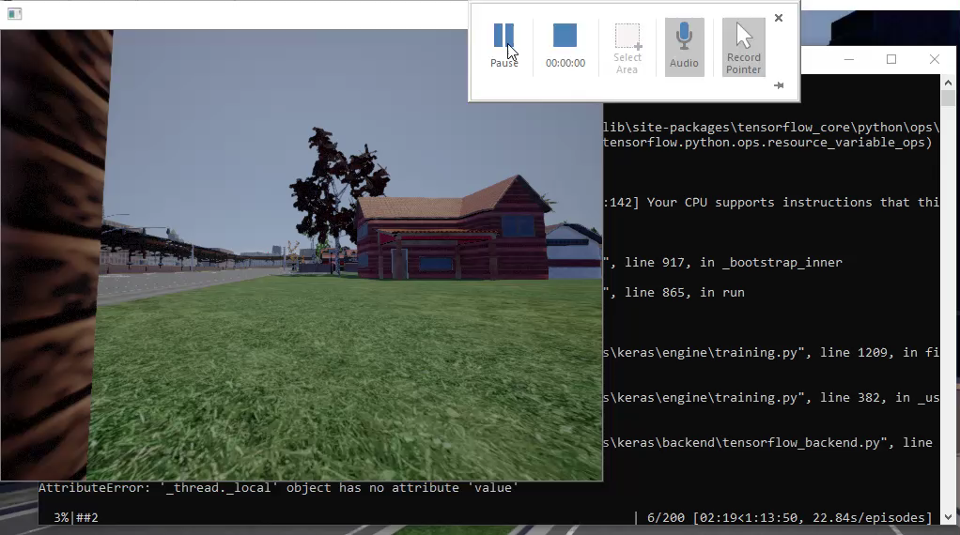
Carla Demonstration video clip

Slide 2
Demo 2

